Slide 1
Sorting rows using the ORDER BY clause
Sort the retrieved rows with the ORDER BY clause:
ASC: Ascending order, default
DESC: Descending order
Syntax:
SELECT [DISTINCT] *[{, [DISTINCT] column [alias],...}]
FROM table
[WHERE condition(s)]
[ORDER BY {column, expr, numeric_position} [ASC|DESC]];
In the syntax:
ORDER BY Specifies the order in which the retrieved rows are displayed
ASC Orders the rows in ascending order (this is the default order)
DESC Orders the rows in descending order.

Slide 2
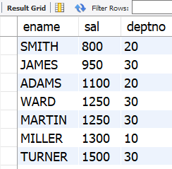
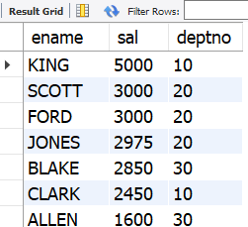
Eg:
select ename,sal,deptno from emp
order by sal asc;
Eg:
select ename,sal,deptno from emp order by sal desc;
select ename,sal,deptno from emp order by 2 desc;
select ename,sal,deptno from emp order by
salary desc;

Slide 3
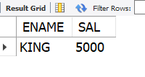
LIMIT Clause
SELECT expressions FROM tables
[WHERE conditions]
[ORDER BY expression [ ASC | DESC ]]
[LIMIT number_rows];
It specifies a limited number of rows in the result set to be returned based on
Number rows.
For example, LIMIT 10 would return the first 10 rows matching the SELECT criteria.
This is where sort order matters so be sure to use an ORDER BY clause appropriately.
SELECT ENAME,SAL FROM EMP ORDER BY SAL DESC
LIMIT 1;

Slide 4
Aggregate Functions
Group functions operate on sets of rows to give one result per group.
Types of Group Functions
AVG →average of numbers.
COUNT→number of rows
MAX →maximum value
MIN →minimum value
SUM →addition of values
SYNTAX:
SELECT group_function(column), ...
FROM table
[WHERE condition];

Slide 5
The group function is placed after the SELECT keyword. You may have multiple group functions separated by commas.
You can use AVG and SUM for numeric data.
You can use MIN and MAX for numeric, character, and date
data types.
COUNT(*) returns the number of rows in a table
COUNT(expr) returns the number of rows with non-null values for expr:
Group functions ignore null values in the column

Slide 6

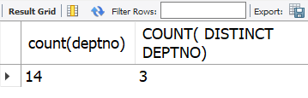
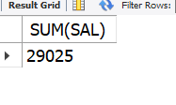
Eg:
SELECT MAX(SAL), MIN(SAL),MAX(ENAME),MIN(ENAME),
MAX(HIREDATE),MIN(HIREDATE)
FROM EMP;
SELECT count(deptno)
,COUNT( DISTINCT DEPTNO) FROM EMP;
SELECT SUM(SAL) FROM EMP;

Slide 7
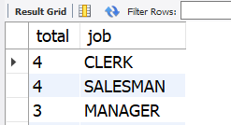
Creating Groups of Data: GROUP BY Clause
You can divide rows in a table into smaller groups by using the GROUP BY clause.
The GROUP BY clause is a SQL command that is used to group rows that have the same values. The GROUP BY clause is used in the SELECT statement. it is normally used with aggregate functions to produce summary reports from the database.
SELECT column, group_function(column)
FROM table
[WHERE condition]
[GROUP BY group_by_expression]
[ORDER BY column];
You can divide rows in a table into smaller groups by using the GROUP BY clause.
Eg:
select count(empno) as total ,job from emp group by job;
You can use a column alias in
the GROUP BY clause

Slide 8
Restricting Group Results with the HAVING Clause
The WHERE clause restricts rows, whereas the HAVING clause restricts groups.
SELECT column, group_function
FROM table
[WHERE condition]
[GROUP BY column]
[HAVING group_condition]
[ORDER BY column];
You cannot use the WHERE clause to restrict groups.
You use the HAVING clause to restrict groups.
You cannot use group functions in the WHERE clause
Nesting Group of Functions not allowed in MySQL.

Slide 9
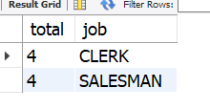
Eg:
select count(empno) as total ,job
from emp group by job
having count(empno)>3;

